Slide 1
Neural network training
Gal Lindič, Ožbej Golob, Žan Jonke

Slide 2
Neural network training
Forward pass algorithm
Loss calculation
Backward pass algorithm
The network has 1 hidden of variable size layer
We experimented with varying batch size and hidden layer size

Slide 3
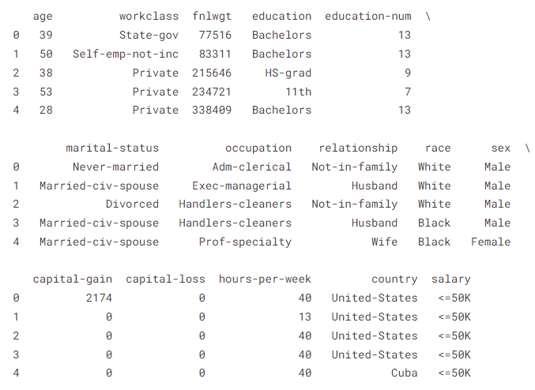
Dataset
US Adults dataset
32561 entries (24421 train and 8140 test)
14 features and 1 class variable (sex)

Slide 4
OpenMP implementation
Parallelization done row-wise ie. one thread per row
In matrix multiplication one thread per dot product
In layer activation one thread per row
In loss calculation one thread per sample
In hadamard product one thread per row
A
B
C
X
…
=
…

Slide 5
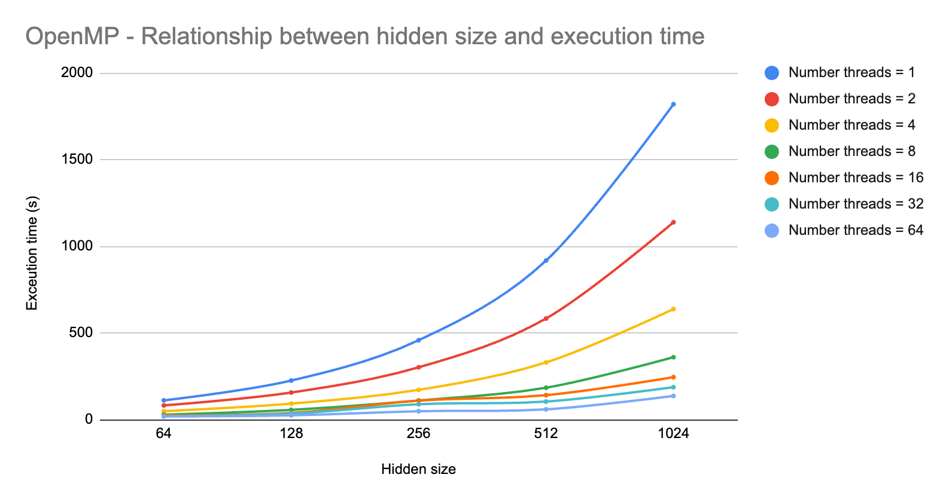
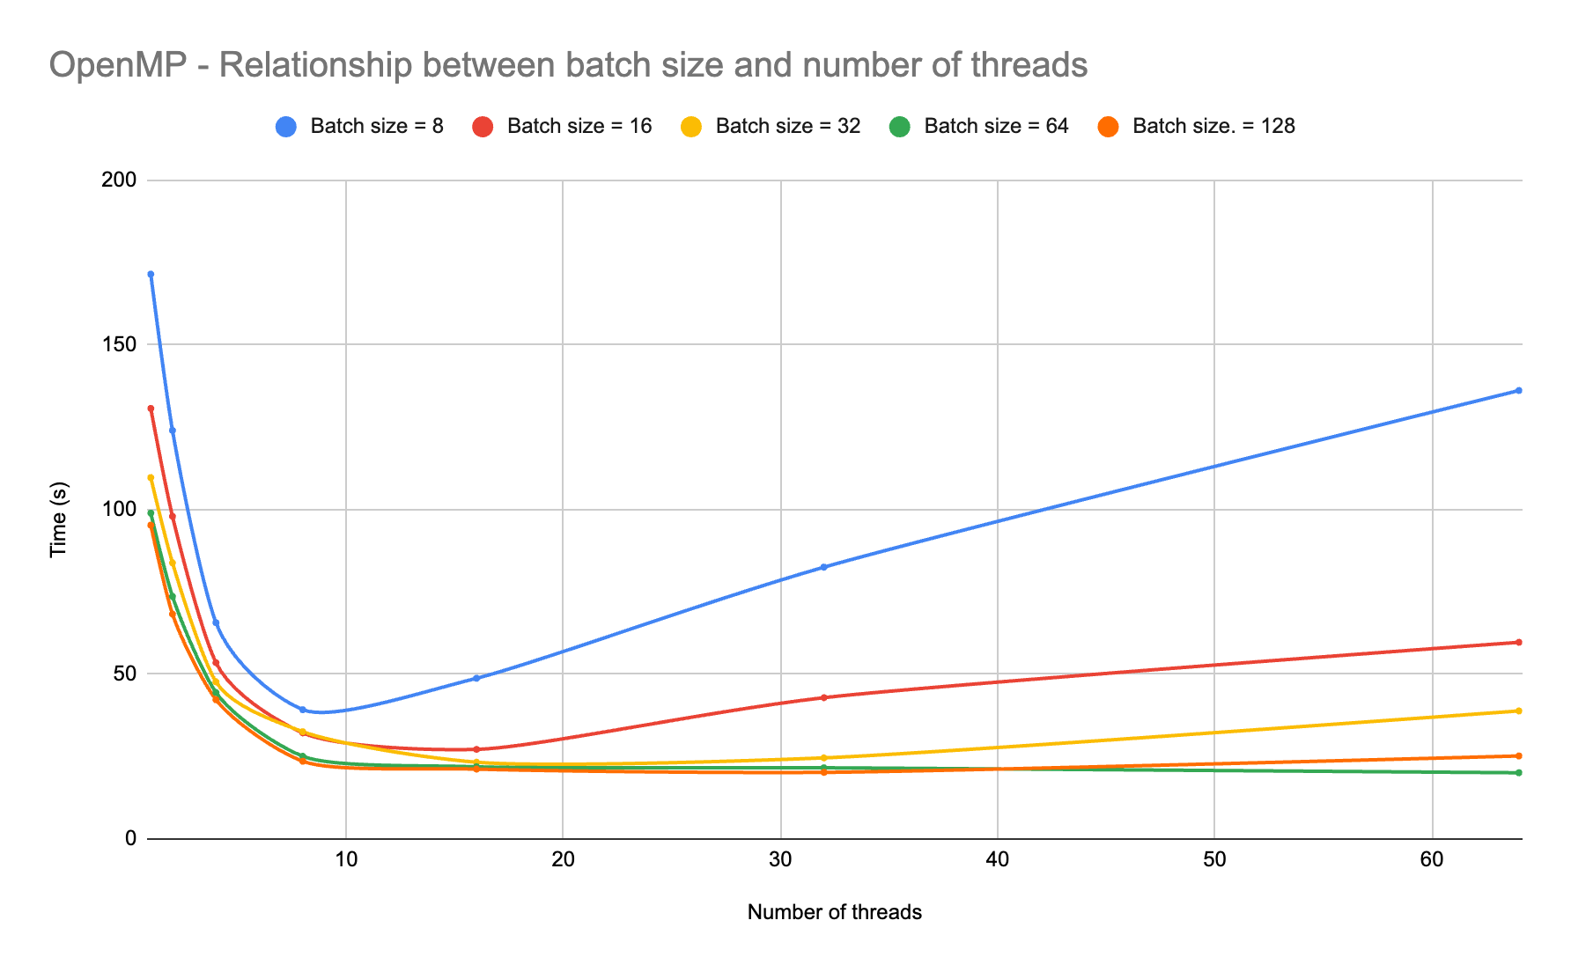
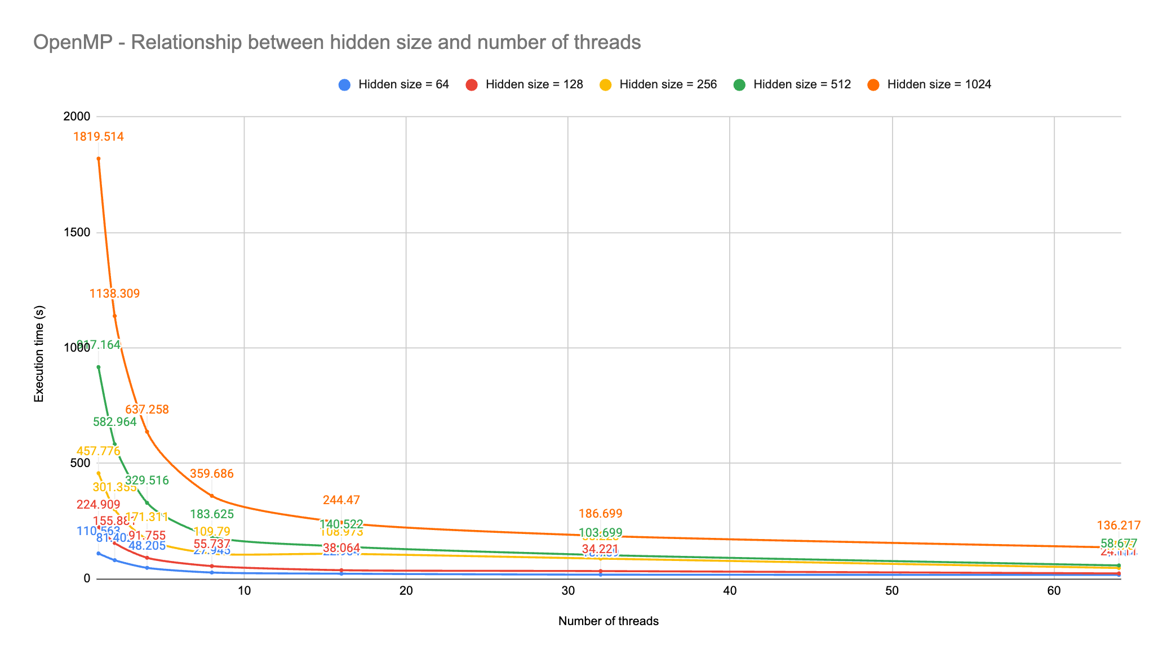
OpenMP benchmarking
Increasing the number of threads pays off for larger hidden size
For small batch sizes computing on large
number of cores does not pay of

Slide 6
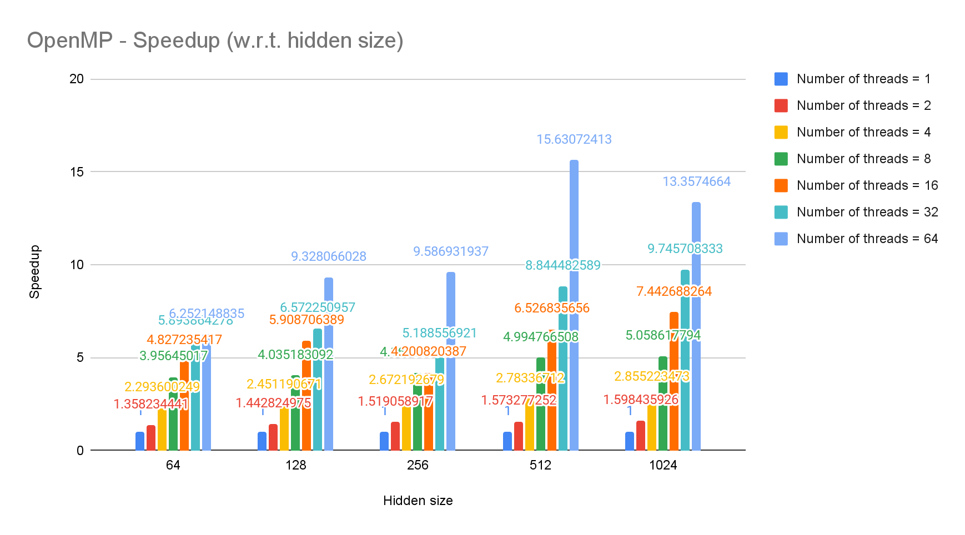
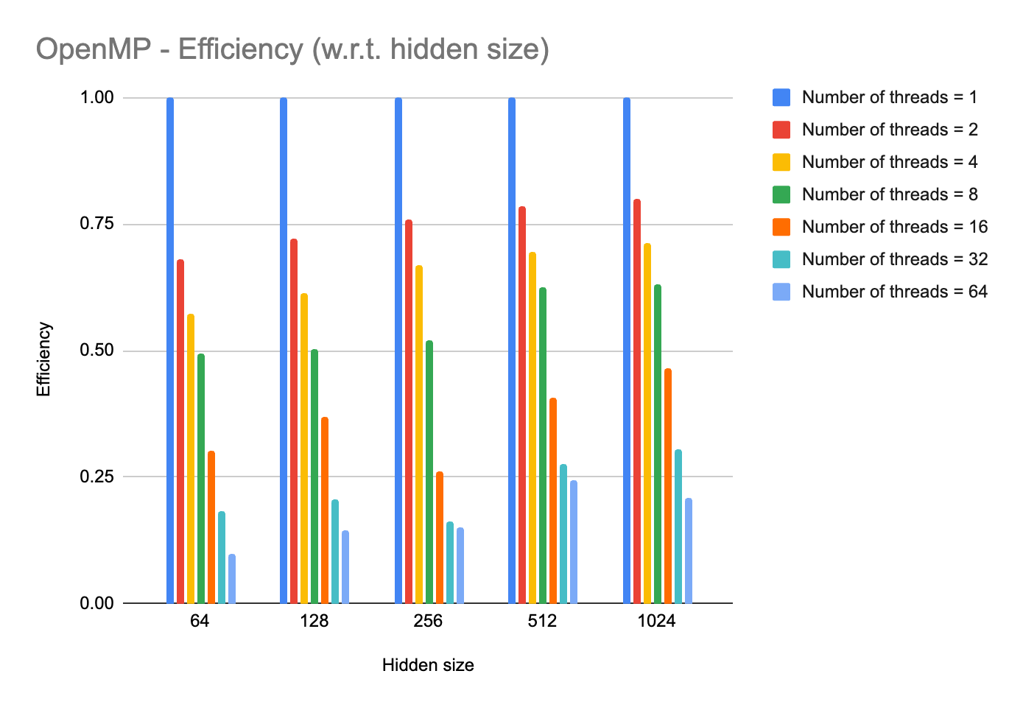
OpenMP benchmarking
Noticeable increase in speedup for larger hidden size
Efficiency deteriorates

Slide 7
CUDA implementation
Multiple kernels that handle different calculation tasks
Dataset and MLP matrices stored in global GPU memory
Number of threads in a kernel equals batch size
Parallelization done row-wise
Each thread handles one row from batch data
Cases when there are matrices with more rows than threads, we divide the rows equally among threads
Batch size = grid_size * block_size
0
1
2
n
0
1
2
n
0
1
2
n
Block 0
Block 1
Block n

Slide 8
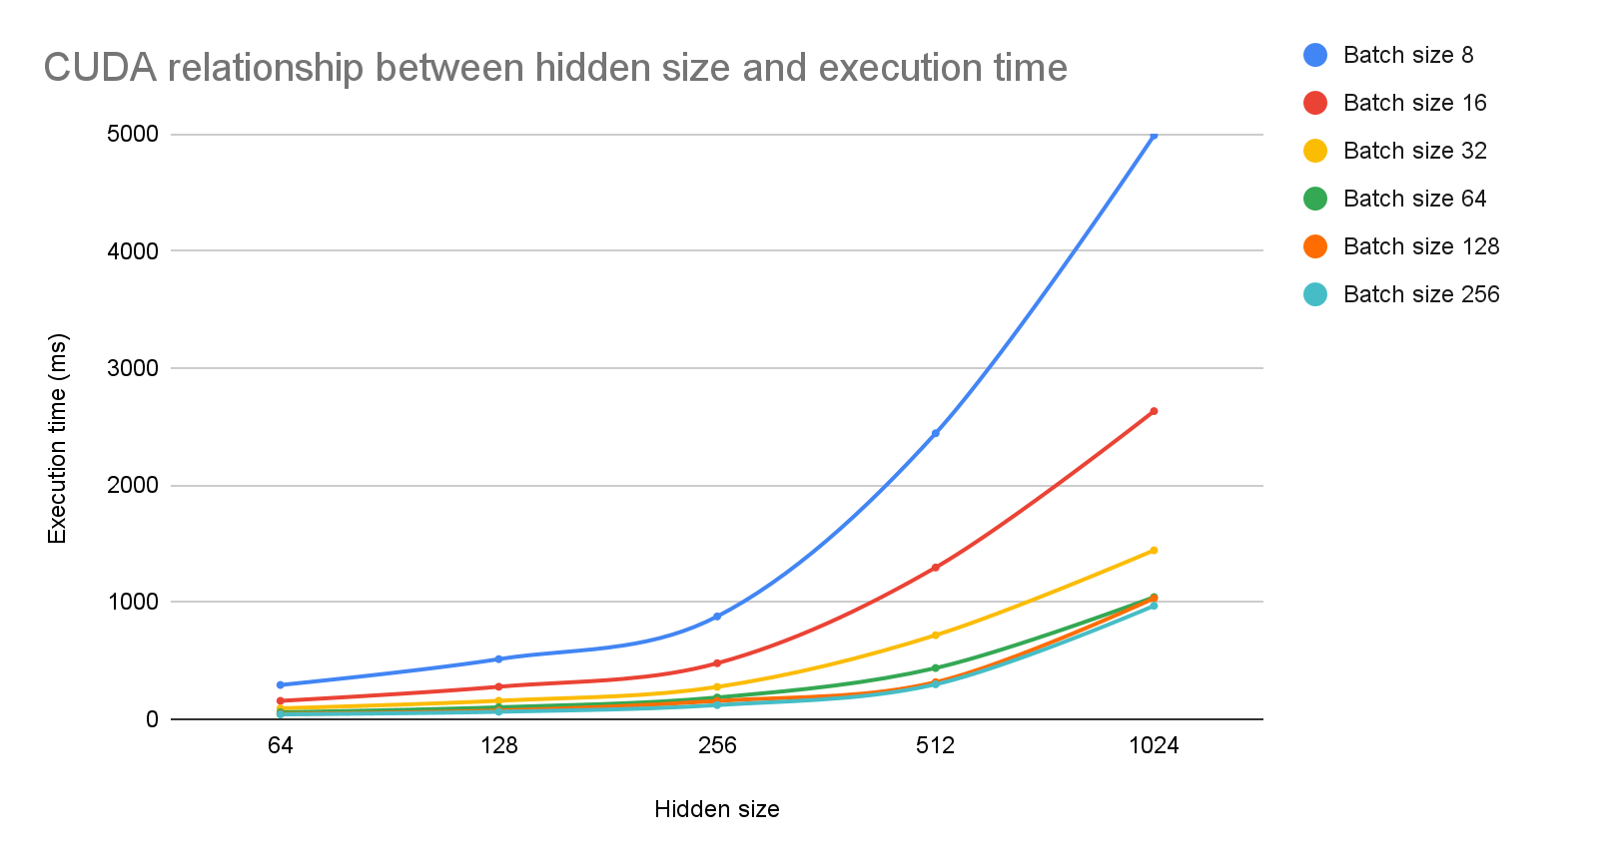
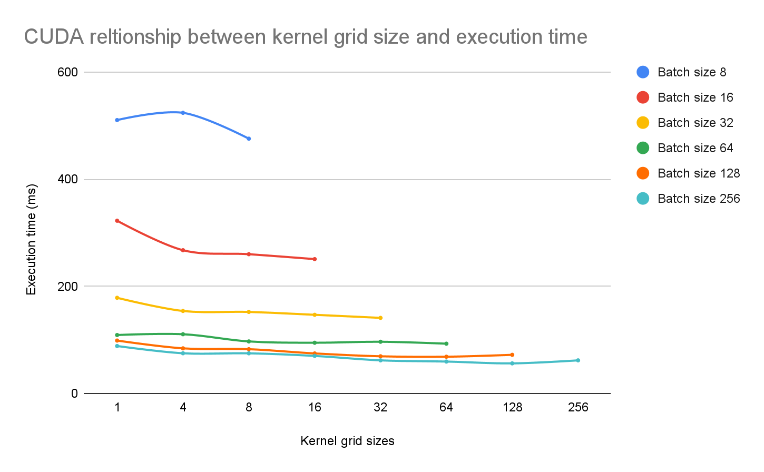
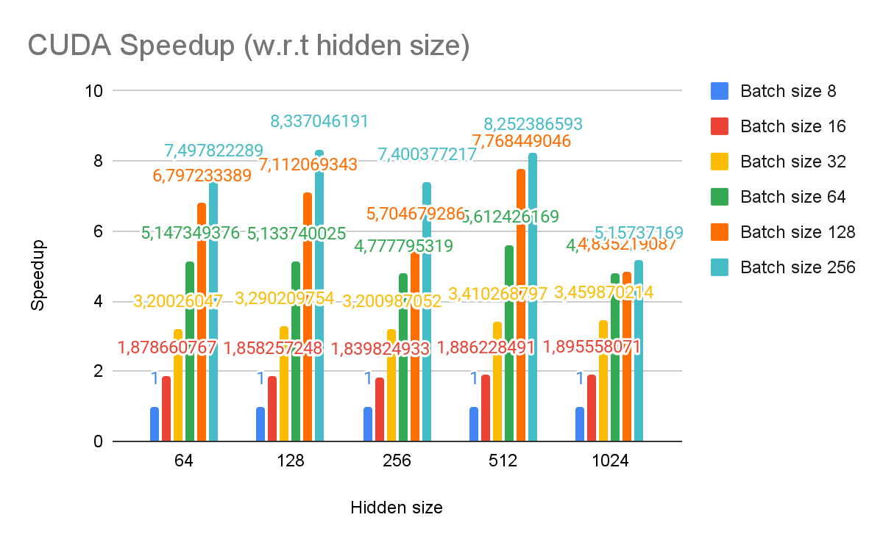
CUDA benchmarking
Increase in batch size greatly improves execution time
Having higher grid sizes (more blocks in kernel) slightly improves execution time

Slide 9
MPI implementation
Parallelization done by splitting into smaller problems
MPI_Scatterv to distribute the uneven load (matrix A)
MPI_Bcast to broadcast the matrix B
MPI_Gather to consolidate the results into matrix C
Other computations follow the same pattern (adding bias, hadamard product …)
A
B
C
…
…
X
…
=

Slide 10
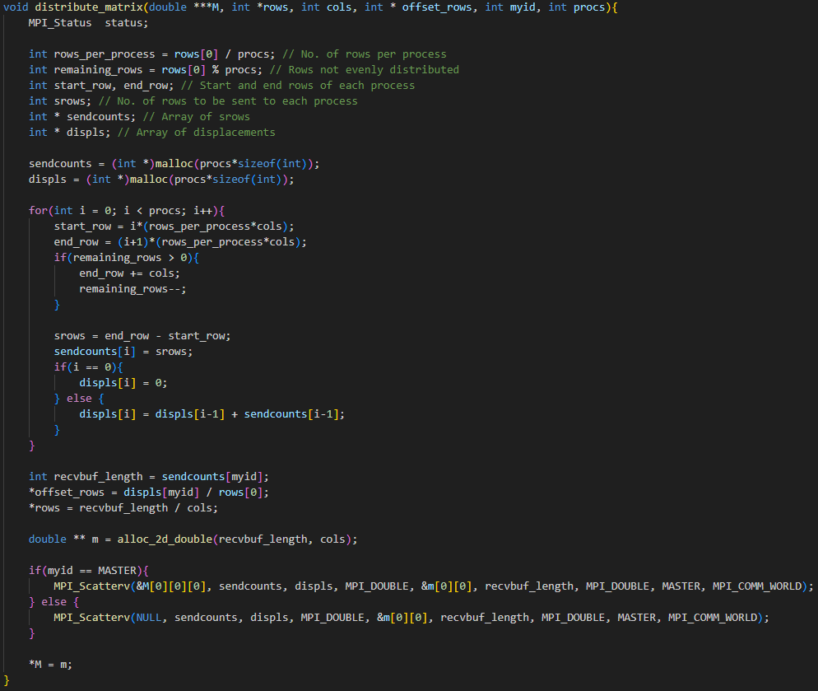
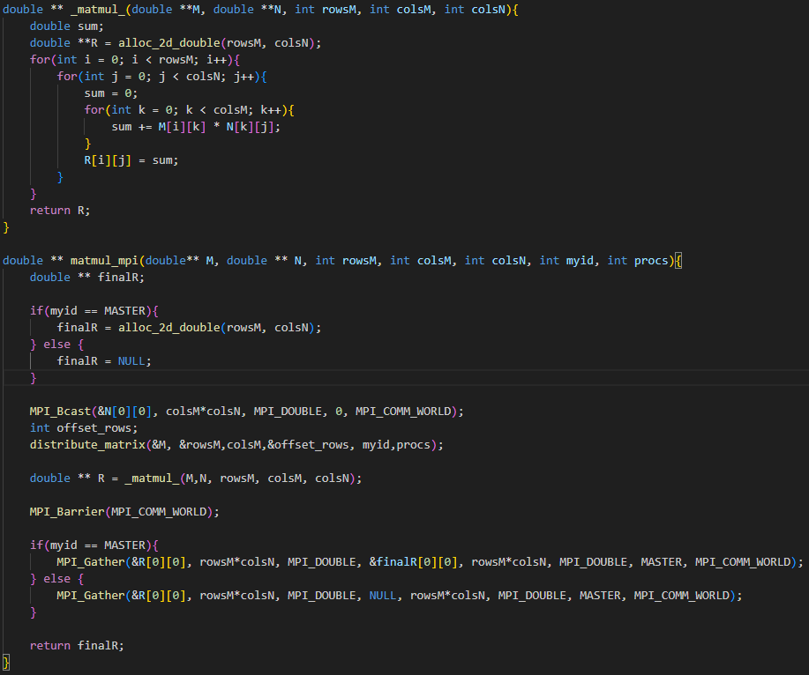

Slide 11
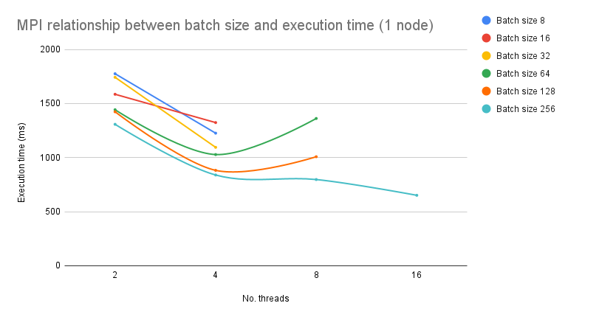
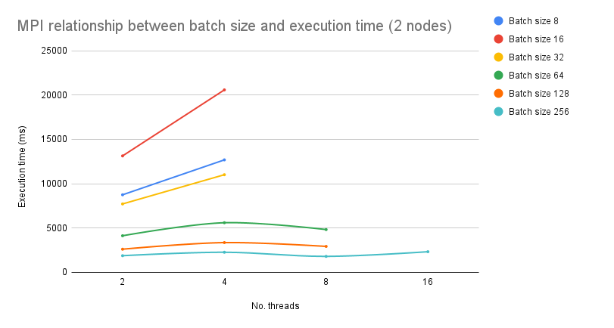
MPI benchmarking
1 node works faster than 2 nodes
Increased batch size yields lower execution times

Slide 12
QA

